Slide 1

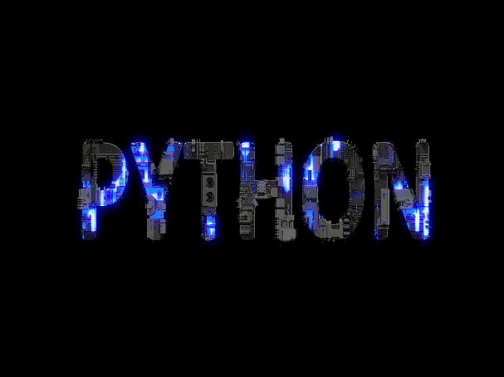

Python Camp
Made by Mohamed Ramadan
Level-1 Lecture-2
Hashira club(reboot)

Slide 2

Who is me?
Linkedin
Mohamed Ramadan:
Monitor
www.linkedin.com/in/mohamed-ramadan-111aab29b
2nd year at FCAIH
Basic Programming concept & OOP & Data structure by Python
Started course at Itida at back-end development by Python freelance

Slide 3


Content
Simple Mathematical Operators
Mathemamtical Built-in function
Simple Operator Precedencenal
if,else condition
Boolean operators
Comparisons

Slide 4
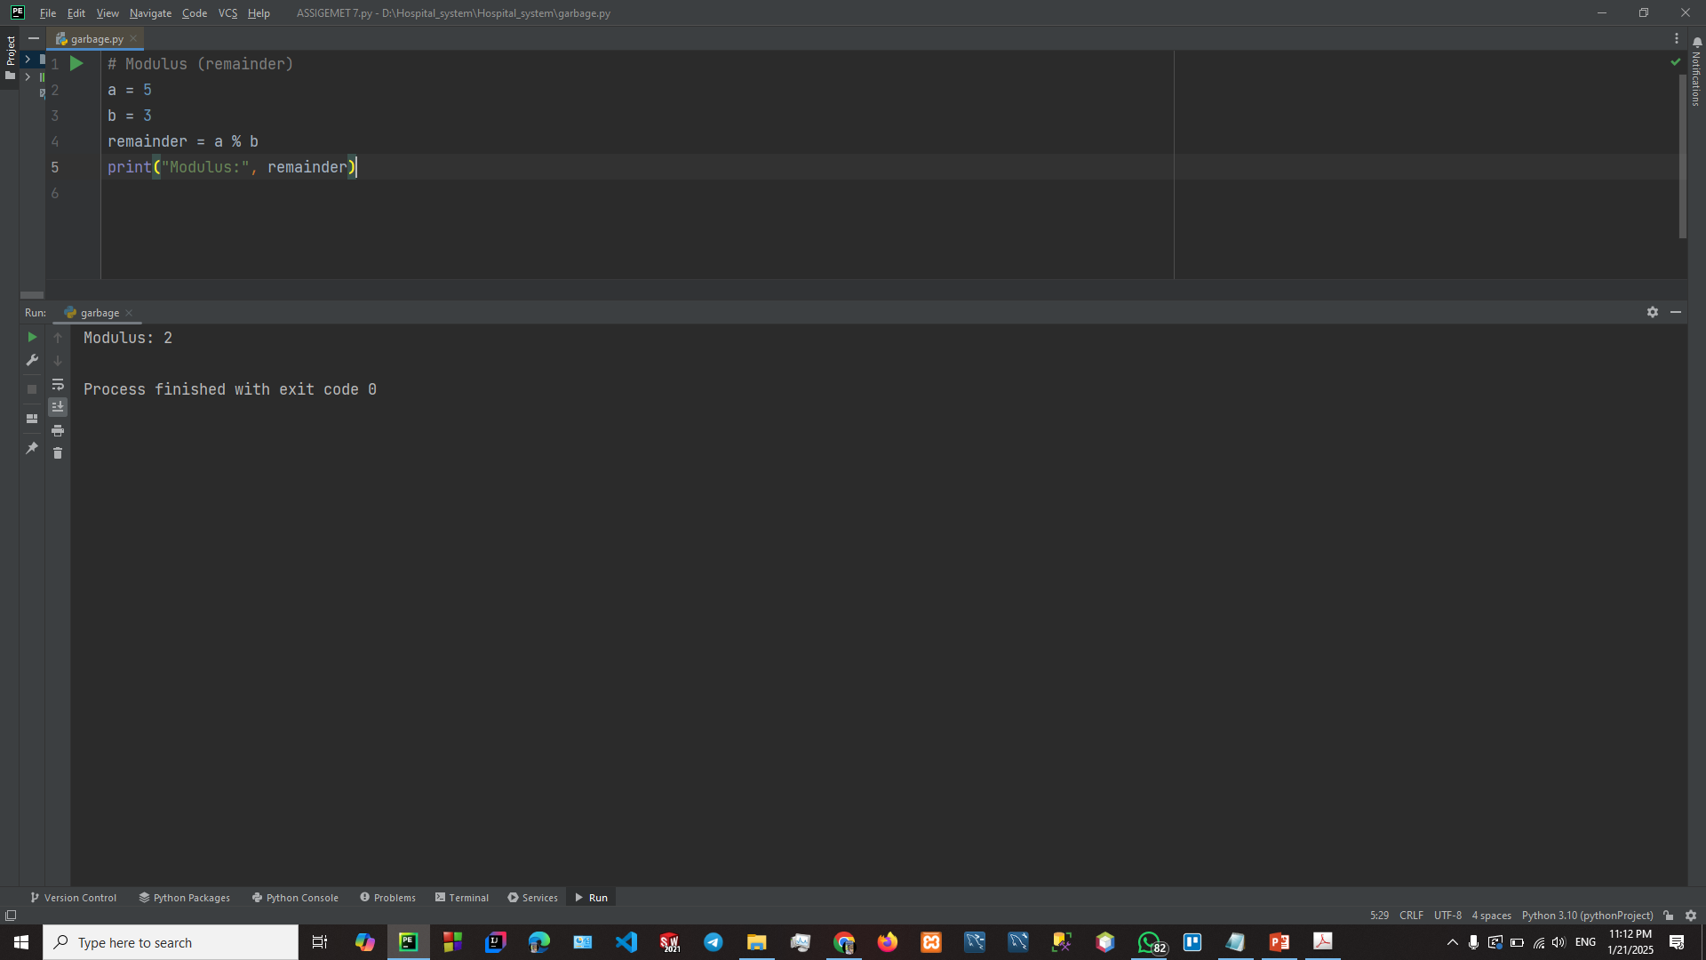


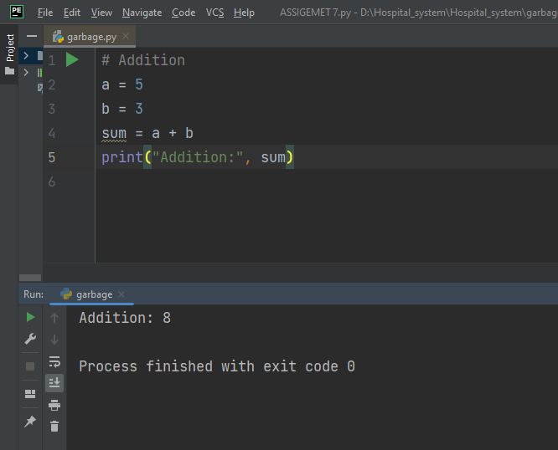

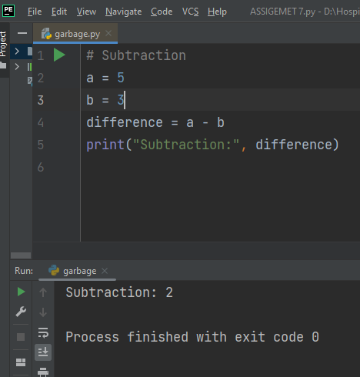

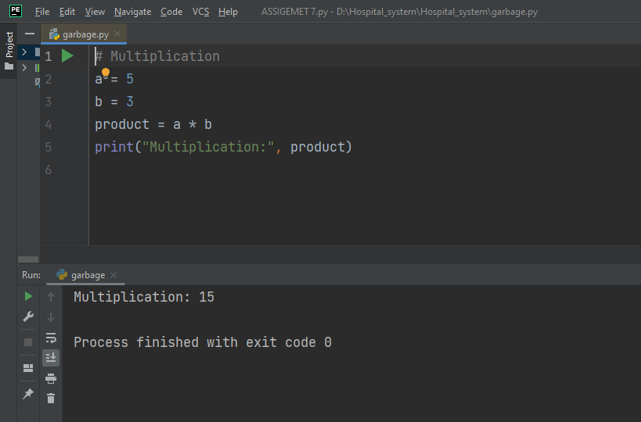
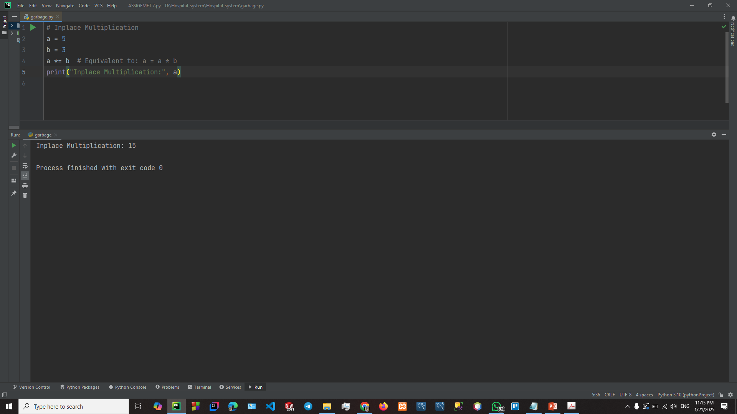

Simple Mathematical Operators
Addition
2-Division
3-Trigonometric Functions
4-Inplace Operations
5-Subtraction
6-Multiplication
7-Logarithms
8-Modulus

Slide 5
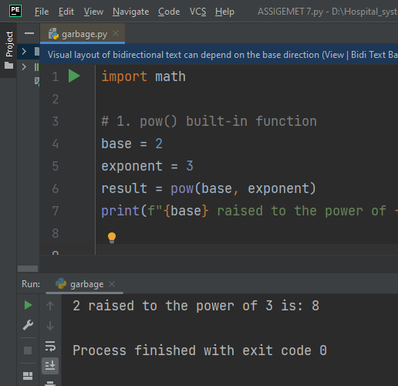
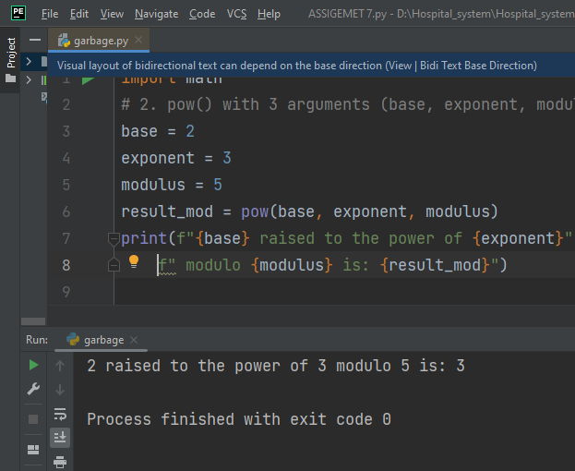

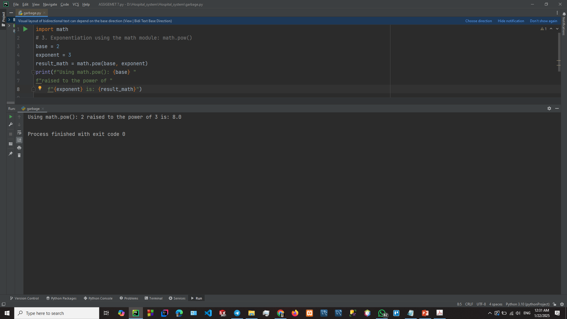
Mathemamtical Built-in function
1- pow() built in function
2- pow() with 3 argument
3-Exponentiation using the math module:
math.pow()
4-Square root: math.sqrt()

Slide 6
Simple Operator Precedence
Python follows PEMDAS rule. PEMDAS stands for Parentheses, Exponents, Multiplication and Division, and Addition and Subtraction.
Example:
>>> a, b, c, d = 2, 3, 5, 7
>>> a ** (b + c) # parentheses 256
>>> a * b ** c # exponent: same as `a * (b ** c)`
7776
>>> a + b * c / d # multiplication / division: same as `a + (b * c / d)`
4.142857142857142

Slide 7

If,else condition
In Python you can define a series of conditionals using if for the first one, elif for the rest, up until the final
(optional) else for anything not caught by the other conditionals.
number = 5
if number > 2:
print("Number is bigger than 2.")
elif number < 2: # Optional clause (you can have multiple elifs)
print("Number is smaller than 2.")
else: # Optional clause (you can only have one else)
print("Number is 2.")
Outputs Number is bigger than 2
Using else if instead of elif will trigger a syntax error and is not allowed.

Slide 8
Boolean operators
And
OR
NOT
Comparisons
1-Chain Comparisons
2-Comparison by `is` vs `==`
3-Greater than or less than
4- Equal To && Not equal to

Slide 9
THANKS

